Slide 1
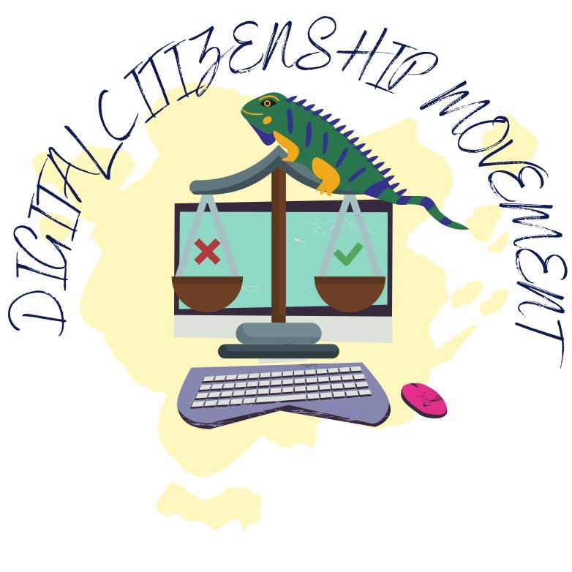
Digital Citizenship Movement in School for Families Nr. 2022-1-LV01-KA210-SCH-000082882

Slide 2
What is Digital Citizenship?
01
02
03
Definition
Importance for Families
Common Digital Citizenship Topics
Digital citizenship encompasses the responsible and ethical use of technology, including online safety, digital literacy, and appropriate behavior in digital environments. It is crucial for navigating the digital landscape effectively.
Understanding digital citizenship is essential for families to ensure the safe and positive use of technology, fostering a healthy online environment for all members.
Topics such as privacy, cyberbullying, information literacy, and digital footprints are integral to digital citizenship education for families.

Slide 3
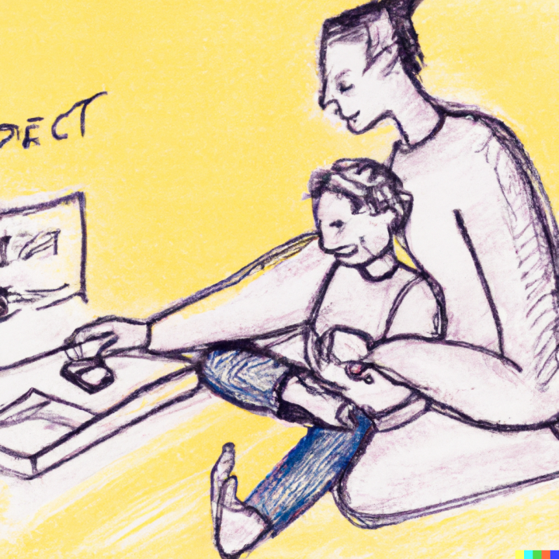
Family Digital Wellness
Promoting Healthy Tech Habits
Encouraging balanced screen time, open communication, and setting boundaries are key components of fostering a digitally healthy family environment.
Resources for Families
Access to family guides, activities, and tips can support the development of digital wellness practices within the family unit.
The online world is rife with mis- and dis-information, and it can be difficult to decide what is accurate, exaggerated, or simply false. Learning to question information found online and engaging respectfully with different viewpoints are core skills for kids growing up in our digital age. You can teach your child to consider what a given author or poster might want them to believe and how to question statements that seem designed to engage their emotions or stir controversy. Encourage them to check those questionable statements or facts on such sites as FactCheck.org, Snopes, or PolitiFact or to look up information on reputable sites.

Slide 4
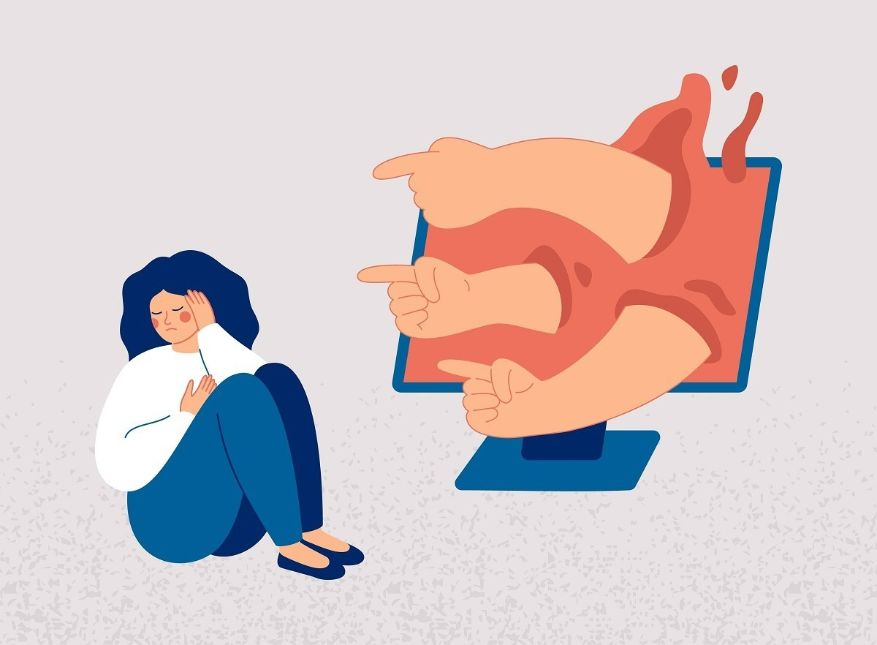
Risks and Challenges
01
Online Safety Concerns
Addressing issues such as identity theft, online predators, and exposure to inappropriate content is crucial for safeguarding family members in the digital sphere.
02
Cyberbullying Awareness
Recognizing the signs of cyberbullying and understanding how to respond effectively is essential for protecting children from online harassment.
03
Digital Literacy
Navigating misinformation, understanding online privacy, and developing critical thinking skills are vital components of digital literacy for families.

Slide 5
Family Digital Citizenship Resources
01
Educational Tools
Access to age-appropriate educational resources, games, and activities can facilitate learning about digital citizenship in an engaging and interactive manner.
02
Parental Control and Monitoring
Utilizing parental control software and monitoring tools can assist parents in managing and supervising their children's online activities effectively.
Trend Micro offers a brief course and conversation starters for parents to use in helping kids to learn about strong passwords, why they’re important, and how to craft really good ones. We could all use a refresher!
03
Community Support
Engaging with other families, educators, and community organizations can provide valuable support and resources for promoting digital citizenship within the family unit.
UNICEF provides a multi-media guide for young people and their parents about digital activism and how to engage in positive, impactful ways.

Slide 6
Building Digital Literacy Skills
Media Literacy Education
Teaching children to critically evaluate media content, discern credible sources, and understand the impact of digital media on society is fundamental for digital literacy.
Tech-Savvy Parenting
Empowering parents with the knowledge and skills to guide their children in using technology responsibly and safely is essential for fostering digital literacy at home.
Learning Through Play
Incorporating educational games, interactive media, and digital storytelling can enhance children's digital literacy skills in an enjoyable and engaging manner.

Slide 7
Family Online Conduct
Positive Digital Behavior
Encouraging respectful and empathetic online interactions, promoting digital empathy, and modeling positive digital behavior sets the foundation for a healthy digital community within the family.
Digital Etiquette
Teaching children about online manners, netiquette, and the importance of respecting others' digital spaces contributes to a positive online environment.
Privacy and Security Practices:
Educating family members about safeguarding personal information, using strong passwords, and recognizing online threats is essential for maintaining digital security.

Slide 8
Parental Guidance and Support
01
Open Communication
Fostering open and honest conversations about online experiences, challenges, and concerns creates a supportive environment for children to seek guidance from their parents.
02
Setting Boundaries
Establishing clear guidelines for online activities, screen time, and content consumption helps parents ensure a safe and balanced digital experience for their children.
03
Leading by Example
Modeling responsible digital behavior, demonstrating healthy tech habits, and showcasing positive online conduct sets the standard for children to emulate.

Slide 9
Digital Citizenship Activities for Families
01
Family Agreements
Collaboratively creating family agreements for digital device usage, online conduct, and digital citizenship practices fosters a sense of shared responsibility and accountability.
03
Community Engagement Involvement in community initiatives, volunteering, or advocacy for digital well-being and online safety promotes a sense of social responsibility and digital citizenship within the family.
02
Media Creation Projects
Engaging in collaborative media creation projects, such as family blogs, vlogs, or digital storytelling, encourages creativity and reinforces positive digital citizenship principles.

Slide 10
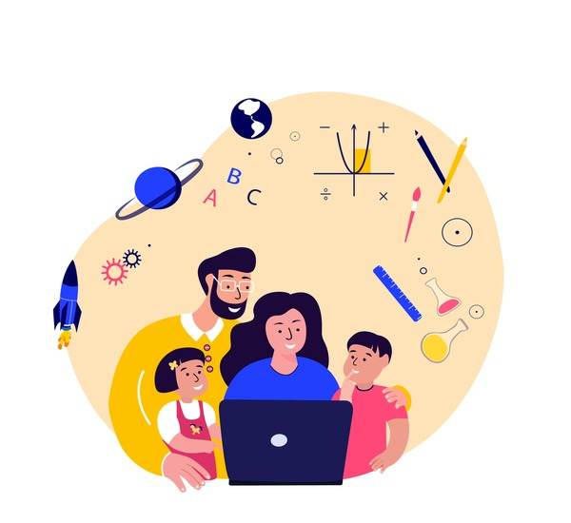
Family Digital Empowerment
01
Digital Skill Development
Providing opportunities for family members to enhance their digital skills, such as coding, online collaboration, or digital creativity, fosters empowerment and confidence in the digital realm.
02
Online Advocacy and Activism
Encouraging family involvement in online advocacy efforts, digital literacy campaigns, or community initiatives empowers families to contribute positively to the digital world.
03
Digital Entrepreneurship
Exploring entrepreneurial opportunities in the digital space and fostering an entrepreneurial mindset within the family encourages innovation and digital empowerment.

Slide 11
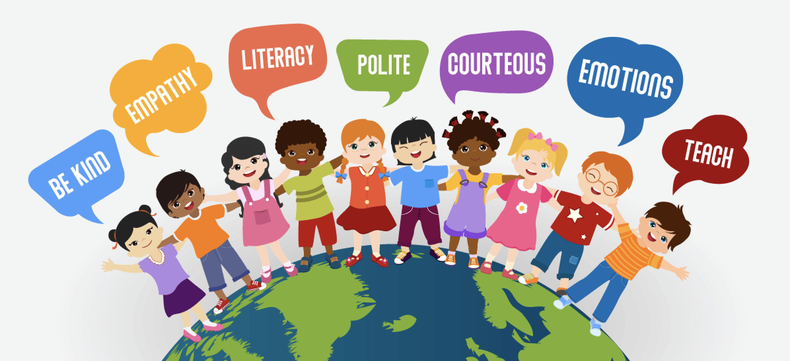
Digital Citizenship and Well-being
01
Balancing Screen Time
Strategies for managing screen time effectively, promoting digital breaks, and engaging in offline activities contribute to overall well-being in the digital age.
02
Mental Health Awareness
Raising awareness about digital well-being, mental health, and the impact of technology on emotional wellness is crucial for nurturing a healthy digital lifestyle.
03
Support Networks
Accessing online support communities, mental health resources, and digital well-being platforms provides families with valuable assistance in navigating digital challenges.

Slide 12
Family Digital Citizenship Commitment
01
Shared Values and Goals
Establishing shared family values and goals related to digital citizenship and online conduct strengthens the commitment to fostering a positive digital environment.
02
Continuous Learning
Embracing a culture of continuous learning, adaptation to digital trends, and staying informed about online safety practices reinforces the family's commitment to digital citizenship.
03
Community Engagement
Actively participating in digital citizenship initiatives, collaborating with educational institutions, and contributing to digital well-being programs demonstrates the family's dedication to thriving in the digital world.

Slide 13
Useful Websites
[Common Sense Education - Family Resources](https://www.commonsense.org/education/family-resources): The K–12 Digital Citizenship Curriculum's Family Tips and Family Activities cover all six curriculum topics and are available in English and Spanish.
1
[Common Sense Education - Digital Citizenship](https://www.commonsense.org/education/digital-citizenship): All students need digital citizenship skills to participate fully in their communities and make smart choices online and in life.
2
[Digital Wellness Lab - Family Guides](https://digitalwellnesslab.org/family-guides/parents-guide-to-digital-citizenship/): It's about keeping personal information and digital devices secure and maintaining mental and physical well-being while engaging online.
3
[PBS LearningMedia - Digital Citizenship Lessons](https://www.pbslearningmedia.org/subjects/engineering--technology/technological-literacy/digital-citizenship/): Find lessons on Digital Citizenship for all grades. Free interactive resources and activities for the classroom and home.
4
[ISTE - Be Internet Awesome(https://iste.org/news/iste-announces-googles-be-internet-awesome-program-earns-the-distinguished-seal-of-alignment)
5
[Edmonton Public Library - Digital Citizenship Resources for Parents](https://epl.bibliocommons.com/list/share/70923485/1989676189): Digital Citizenship Resources for Parents by EPLPicks_Kids.
6

