Slide 1




DIGITAL CITIZENSHIP MOVEMENT IN SCHOOL
Student Lessons
CONCEPT:
“Conscious use of technology"
EXERCISE NAME:
Good and bad in technology
AIM:
exercIse name:
To evaluate if your students are conscious about the risks for their health.
METHODOLOGY
  Introduce the topic through a debate with some pictures ;
  https://docs.google.com/presentation/d/1m5fKRv8etXiEfGvC1hH0_1n7dokrUMVoqfXNB3SMt20/edit?usp=sharing
  Draw your body and write the consequences of an improper use of technology (the students will receive a photocopy or the drawing and they can work in pairs)
  Find out what actions and activities you can write on each side of the scales (use the material on page five )
REFLECTION QUESTIONS (CHILDREN OR FACILITATOR)
How do you feel when you spend too much time in front of a screen?
Why do you spend so much time in front of it?
https://wordwall.net/resource/66267561 (this game is used to make the students think about their personal experience)
REFERENCES:
LESSON #:
1

Slide 2

DIGITAL CITIZENSHIP MOVEMENT IN SCHOOL
Student Lessons
CONCEPT:
“Cyberbulling"
EXERCISE NAME:
My online action programme
AIM:
To create a personal plan about how to solve some online problems
METHODOLOGY
  Introduce the topic through a debate with some key words and brainstorming;
  https://docs.google.com/presentation/d/1dlsToRteL4Sl7aBkHuAaxiiO9BZvWoseIUIcyJyLf5Q/edit?usp=sharing( this is the presentation to use);
  Create a personal plan and a class plan showing some instruction to follow. ( use the materials on pag. 6 and 7),
  write a review of an App you use and give suggestions about safety and positive functions.
REFLECTION QUESTIONS (CHILDREN OR FACILITATOR)
WHO SHOULD YOU TRUST?
WHO CAN YOU SHARE SOME PERSONAL DATA WITH?
WHO CAN YOU ASK FOR HELP IF YOU HAVE PROBLEMS ONLINE?
REFERENCES:
LESSON #:
2

Slide 3

DIGITAL CITIZENSHIP MOVEMENT IN SCHOOL
Student Lessons
CONCEPT:
“Safe Internet use"
EXERCISE NAME:
My ideal social network
AIM:
To identify the main characteristics of a social network, safe for children.
METHODOLOGY
  Introduce the topic through a debate with some example of Apps or social networks they use; let’s talk about it. We can create a slide with the students’ suggestions.
Find all the elements that a safe social network
requires, through questions and group work.
REFLECTION QUESTIONS (CHILDREN OR FACILITATOR)
DO YOU LIKE SOCIAL NETWORKS?
ARE THEY USEFUL?
THINK ABOUT WHAT YOU DO ON THE INTERNET: IS IT
RIGHT OR WRONG?
WHAT ARE THE MAIN CHARACTERISTICS OF A GOOD SOCIAL NETWORK?
REFERENCES:
LESSON #:
3

Slide 4
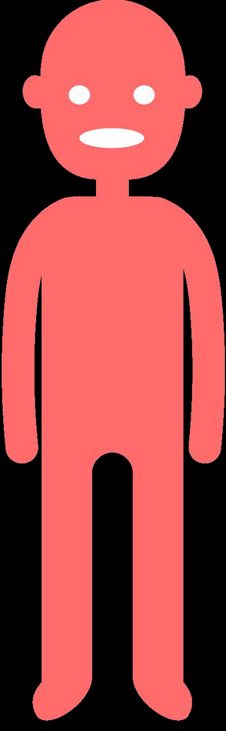



lesson resources- 1
We’ll show the students some pictures and we’ll discuss about some problems related to an extreme use of technology ( staying in front of the screen for hours, watching a lot of videos, also before sleeping, forcing our eyes ........)
SLEEP
SIGHT
POSTURE
MOOD
CONCENTRATION
DIET
PHYSICAL EXERCISE
THEY’LL PLAY A DIGITAL GAME WITH CARDS AND TRY TO ANSWER SOME QUESTIONS. THEY’LL THINK ABOUT THE CONSEQUENCES OF AN INADEQUATE USE OF DEVICES. THEY’LL WRITE THEIR OPINIONS ON A PAPER WHICH SHOWS AN IMAGE OF A PERSON AND THE AREAS THAT ARE INVOLVED IN THE PROBLEM. THEN A BIG CARDBOARD WITH THE SAME IMAGE WILL BE CREATED. THEY WILL WRITE ALL THEIR ANSWERS ON IT
4

Slide 5

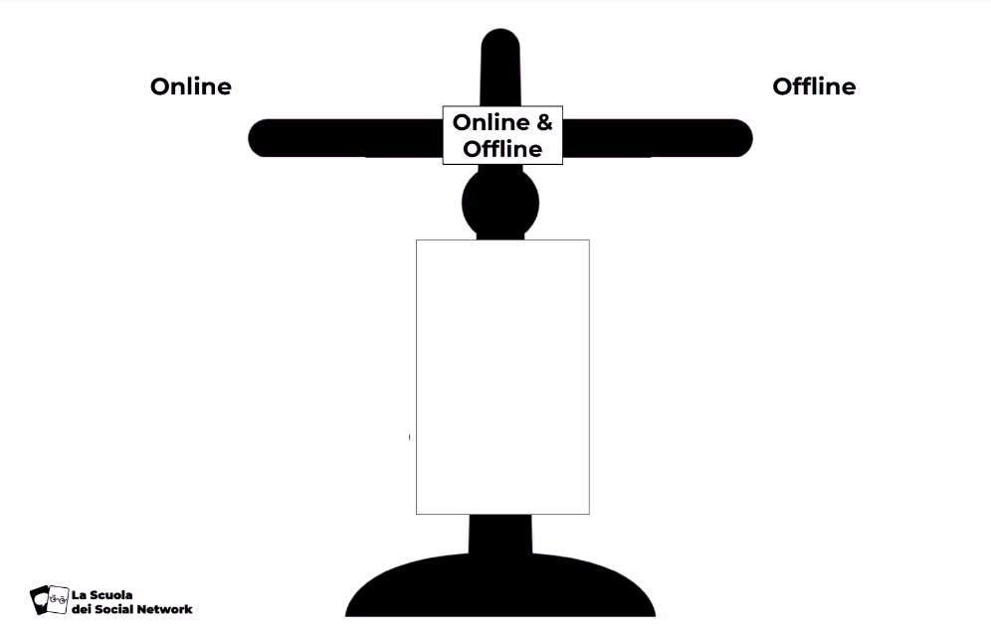
lesson resources- 1
Healthy balance
They will make a list of activities they do online or offline and share opinions about the healthy balance of their daily routine.
ONLINE
OFFLINE
5

Slide 6


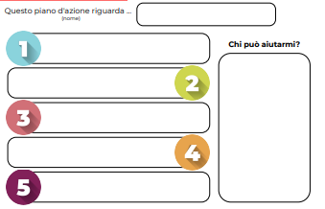
lesson resources-2
THE STUDENTS WILL CREATE A PLAN ABOUT WHAT THEY CAN DO IF THEY SEE OR READ ANYTHING THAT THEY CONSIDER NOT ADEQUATE OR WORRYING. THEY WILL WORK TOGETHER AND PRODUCE A CARDBOARD ( LIKE THE ONE WE SEE HERE) AFTER DISCUSSING ABOUT THE TOPIC.
This action plan is by.....
Who can help me?
6

Slide 7
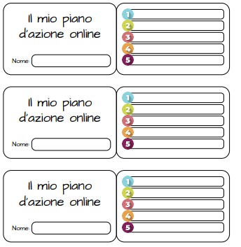
lesson resources-2
THE STUDENTS WILL ALSO CREATE SMALL CARDS WITH THE SAME INSTRUCTIONS THEY CAN KEEP AT SCHOOL OR AT HOME AND FOLLOW THEM WHEN NEEDED. THEY CAN ALSO GIVE THE SMALL CARDS TO OTHER STUDENTS OF THE SCHOOL.
My online action plan
7

Slide 8

LESSON RESOURCES - 3
The students have to invent a social network, but they need to consider these areas and think about the importance of these parameters before they realize it.
CHARACTERISTICS
USERS
DATA
SAFETY
What can users do?
Think of your interests and hobbies
Who is it for?
Can other people use it, or just children?
What type of personal data do you collect?
Are children under the age of 13 authorized?
How can you protect data?
Do they need a password?
Accessibility
Contacts
CONTENTS
Behaviour
Is it good for users with disabilities
or special needs?
Do they need an invitation
for the registration?
How will you block negative contents?
Who can disseminate?
What is good or bad online?
Who is responsible?
What can the consequences be?
Private or public messages?
Proof of identity?
Age
WARNING
WELLNESS
FUN
What type of contents?
How are they created or shared?
Can users advise you if they need any help?
What instruments will you give them?
How will you help the users stay happy and healthy on your platform?
How will you convince the children to subscribe and use your social network?
8

Slide 9
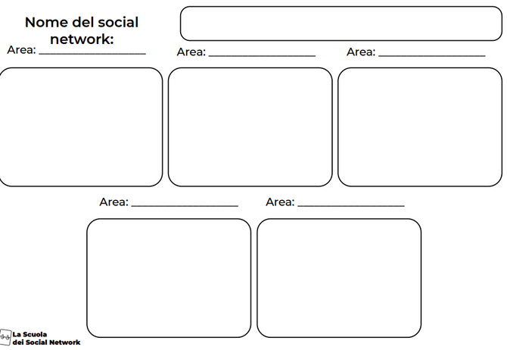
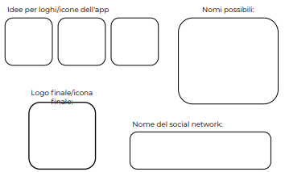
lesson resources - 3
NOW IT’S UP TO YOU!
REALIZE YOUR IDEAL SOCIAL NETWORK: THINK OF A POSSIBLE NAME AND ANALYZE THE AREAS OF INTEREST.
THEN INVENT A LOGO OR AN ICON.
Name of the social network
Ideas for a logo or an icon
Possible names
Final logo or image
Name of the social network
9

Slide 10

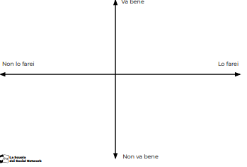
Pay a monthly subscription for a popular streaming music service | Copy popular music songs from your friend’s device | Download a free online game offered by a company
LESSON RESOURCE S -
3
USE AN IMAGE FOUND ONLINE, FOR YOUR WORK, WITHOUT THE AUTHOR’S PERMISSION
USE A NON - OFFICIAL WEBSITE TO WATCH A SPORT EVENT FREELY
Download an audio book as a part of a free trial period
Watch episodes of your favourite cartoon that someone uploaded on a video sharing service
Install an app that is in your “Family library” on an app store
Use a software to download music from video online
Pay a monthly subscription to download new games for your devices
You can stream videogames you don’t own and play
Download a movie uploaded at the cinema by someone on their mobile
The students also have to decide what things they can do and what things are not allowed
It’s ok
I wouldn’t do it
I would do it
This is not good
10

