Slide 1







DIGITAL CITIZENSHIP MOVOMENT IN SCHOOL
Student Lessons
-CONCEPT DESCRIPTION THROUGH VIDEO -PAINTING ACTIVITY WITH TEAM WORK
CONCEPT: EXERCISE NAME:
E SOCIALIZATION AND IDENTITY STORAGE
AIM:
THE AIM OF THIS EXERCISE IS; THE AIM IS TO ENABLE STUDENTS TO USE THE CHAMELEON AS A METAPHOR. A VIDEO EXPLAINING DIGITAL CITIZENSHIP IS PLAYED. THEY ARE ASKED TO COLOR CHAMELEON DRAWINGS. WHILE PAINTING, STUDENTS REALIZE THAT IT IS POSSIBLE TO CHANGE THEIR IDENTITY IN THE DIGITAL ENVIRONMENT, LIKE A CHAMELEON CHANGING COLOR QUICKLY.
METHODOLOGY
STUDENTS FREQUENTLY USE E-SOCIALIZATION TOOLS OR GAMES INVOLVING CHAT TO COMMUNICATE WITH VIRTUAL PEOPLE. THE PERSON HE CONTACTS MAY NOT ACTUALLY HAVE A REAL IDENTITY. STUDENTS MUST BE AWARE OF THIS ISSUE. THE USE OF METAPHOR IS IMPORTANT IN MAKING THE INFORMATION PERMANENT. WITH THE PROJECT LOGO, THE CHAMELEON, AWARENESS IS RAISED ABOUT IDENTITY CHANGE IN THE DIGITAL ENVIRONMENT.
REFLECTION QUESTIONS (CHILDREN OR FACILITATOR)
WHAT DO YOU THINK IS THE MOST KNOWN FEATURE OF A CHAMELEON? AFTER THE VIDEO YOU WATCHED, DO YOU REMEMBER HAVING EVER SEEN A CHUCELON IN A DIGITAL ENVIRONMENT BEFORE? (SO HAVE YOU SEEN ANYONE HIDING HIS IDENTITY IN A DIGITAL ENVIRONMENT BEFORE?) AFTER THIS LESSON, CAN YOU REALIZE THAT THE PEOPLE WE WILL ENCOUNTER IN THE DIGITAL ENVIRONMENT MAY HAVE THE POSSIBILITY OF HIDING THEIR IDENTITY? PREPARE YOUR AVATAR WITH BITMOJI OR PIXTON APPLICATIONS BY THIS WEEK AND BRING IT TO CLASS.
REFERENCES:
LESSON #:
1

Slide 2

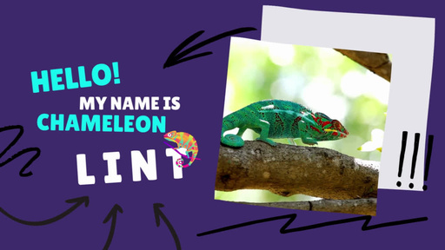

lesson resources
ROLL PAPER WITH VARIOUS CHAMELEON IMAGES IS PRINTED. ROLL PAPER IS CUT TO A SUFFICIENT LENGTH FOR ALL CLASSES IN THE SCHOOL. ALL OF HIS STUDENTS COLOUR THEIR CHAMELEONS COLORED ON THE SAME PAPER. THE TEACHER EMPHASIZES HOW MANY VARIETIES OF CHAMELEONS CAN BE. IT ALSO DRAWS ATTENTION TO THE DIVERSITY OF IDENTITIES USED IN THE DIGITAL ENVIRONMENT. THE CONTENT TO BE PRINTED ON ROLL PAPER IS FOUND ON THE PAGE BELOW.

Slide 3
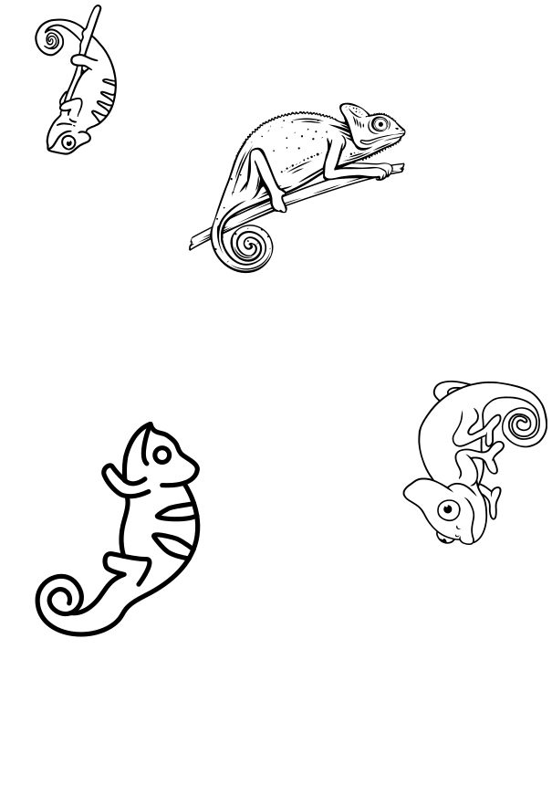

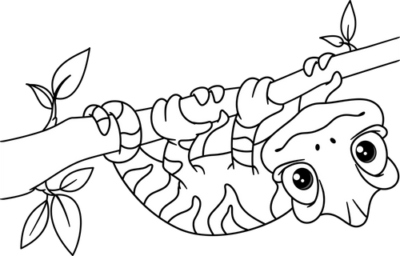

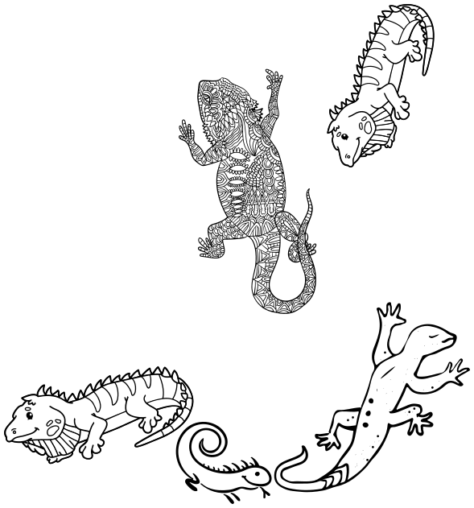

Slide 4
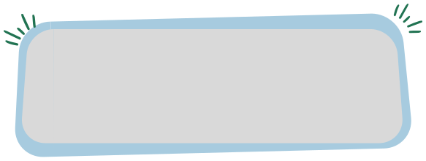


DIGITAL CITIZENSHIP MOVOMENT IN SCHOOL
Student Lessons
MAKING RULES, TEACHING DIGITAL CITIZENSHIP SKILLS THROUGH GAMING
DIGITAL CITIZENSHIP AGREEMENT, INTERLAND
GAME PROMOTION, SLOGAN MATCHING
CONCEPT: EXERCISE NAME:
AIM:
THE FIRST PURPOSE IS TO ENSURE THAT THE STUDENTS LEARN AND APPLY THE DIGITAL CITIZENSHIP AGREEMENT. FOR THIS, THE ATTACHED CONTRACT IS INTRODUCED AND HANGED ON THE BOARD IN THE CLASS. THE SECOND PURPOSE IS TO INTRODUCE THE INTERLAND GAME AND TO ENSURE THAT THEM LEARN THE DIGITAL CITIZENSHIP INFORMATION IT CONTAINS. GAME PROMOTION IS AVAILABLE ATTACHMENT. THE THIRD PURPOSE IS TO GAMIFICATE THE SLOGANS OF THE PROJECT ANYWHERE IN THE SCHOOL WITH THE HELP OF THE MATCHING BOARD.
METHODOLOGY
FAMILIES MUST BE INFORMED SO THAT STUDENTS CAN IMPLEMENT THE CONTRACT AT HOME. AT THE SAME TIME, THE STUDENT IS INTRODUCED TO THE INTERLAND GAME IN THE CLASS. THEY ARE ASKED TO DOWNLOAD AND PLAY THIS GAME ON THEIR DIGITAL DEVICES AT HOME. FAMILIES SHOULD ALSO BE INFORMED ABOUT THIS. THIS LESSON PLAN MAKE IT EASIER FOR STUDENTS TO BE EDUCATED IN ALL DIMENSIONS OF DIGITAL CITIZENSHIP BY THEIR TEACHERS. FAMILIES MUST BE INFORMED ABOUT THE RESULTS OF THIS COURSE.
REFLECTION QUESTIONS (CHILDREN OR FACILITATOR)
CAN YOU COMPLY WITH THE DIGITAL CITIZENSHIP AGREEMENT? HAVE YOU NOTICED? THIS AGREEMENT PROTECTS US AND OUR ENVIRONMENT FROM DANGERS. HOW ARE YOUR SCORES GOING IN THE INTERLAND GAME? HAVE YOU TRIED THE MATCHING GAME AT SCHOOL?
REFERENCES:
INTERLAND GAME
LESSON #:
2

Slide 5
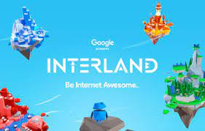
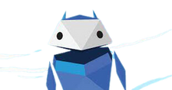
lesson resources
Are you ready to become an intern? program teaches the basic principles of digital world citizenship and what they need to know to be safe, to help children safely explore the world of the internet.
Interland
Children can progress towards becoming Internauts by playing games in Interland. Interland is an online adventure consisting of four challenging games that give kids hands-on practice on important lessons about digital security.
Click to play
Rules of Internship
USE THE INTERNET KNOWINGLY
Share with thought Both good news and bad news spread quickly on the internet. Without much thought, children and young people can find themselves in difficult situations with lasting consequences. Solution? With people they know and people they don't know Learning how to share.
BE CAREFUL ON THE INTERNET
Make Sure It's Real It is important to help children be aware that people and situations on the internet are not always what they seem. Being able to distinguish between what is real and what is fake is a very important lesson in terms of security on the internet.
PROTECT YOURSELF ON THE INTERNET
Keep Your Secrets Personal privacy and security are as important on the internet as they are in the real world. Protecting valuable information prevents damage to children's devices, reputations, and relationships.
BE KIND ON THE INTERNET
Be Good, Be Special The internet is like a powerful speaker that you can use to spread positivity or negativity. kids on the internet By adopting the understanding of "treat others the way you want to be treated yourself" when doing something They can do the right thing.
BE BRAVE ON THE INTERNET
Speak Up When There's a Problem Talking to a trusted adult when faced with a situation They should feel comfortable. Adults encourage open communication at home and school They can support this behavior by encouraging it.

Slide 6

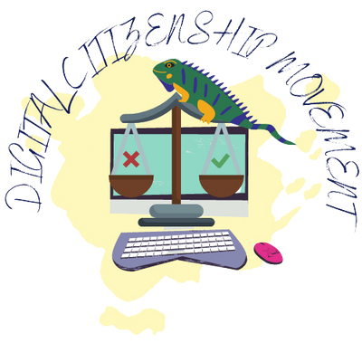



DIGITAL CITIZENSHIP
contract
I DECIDE WITH MY FAMILY WHICH GAMES AND PLATFORMS I WILL USE IN MY DIGITAL TOOLS.
MY PASSWORDS I USE IN VIRTUAL ENVIRONMENT I WILL SHARE WITH MY FAMILY.
I ONLY USE MY AVATAR IN DIGITAL ENVIRONMENT.
I DO NOT USE GAMES AND PLATFORMS THAT ARE NOT APPROPRIATE FOR MY AGE IN THE DIGITAL ENVIRONMENT.
I AM ALWAYS COURTESY IN A DIGITAL ENVIRONMENT.
I USE THE INTERLAND GAME. I APPLY WHAT I LEARN.
FOR DIGITAL CITIZENSHIP AT SCHOOL I PARTICIPATE IN ALL APPLICATIONS.

Slide 7


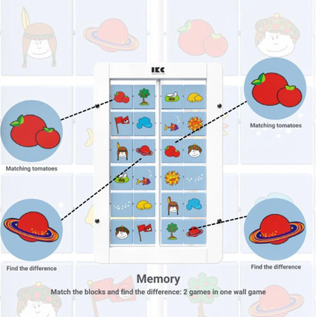
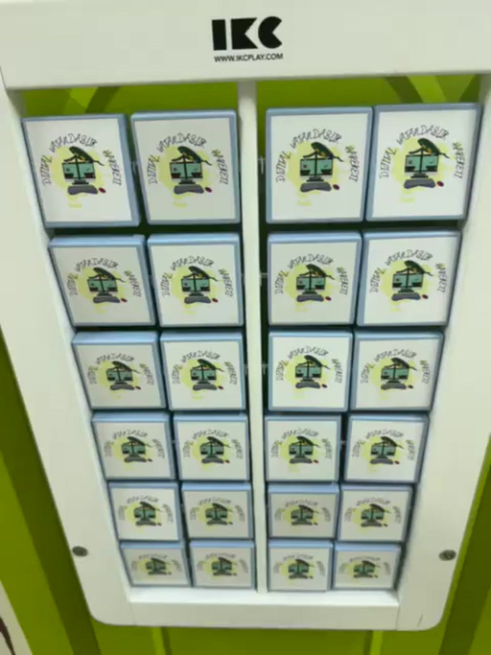
lesson resources
St ckers are ava lable n the l nk. Turn these st ckers nto a match ng game. And prepare a wall board n a certa n corner of your school. You can benef t from wall games prepared for th s. Or you can create a creat ve new board. We chose to personal ze a wall panel w th st ckers we prepared spec f cally for our project. We covered the back of each frame w th our project logo. We pasted st ckers on the front of the squares w th slogans that convey messages about our top c.

Slide 8
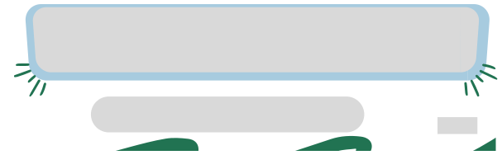
DIGITAL CITIZENSHIP MOVOMENT IN SCHOOL
Student Lessons
CONCEPT: EXERCISE NAME:
STRENGTHENİNG DİGİTAL CİTİZENSHİP ATTİTUDES THROUGH GAMİNG
CHAMELEON MONOPOLY
AIM:
THE AIM IS FOR STUDENTS TO LEARN THE FOLLOWING IN A FUN WAY WITH A GAME. THEY NEED TO PROTECT THEIR PHOTOS AND IDENTİTIES IN THE DIGITAL ENVIRONMENT. HOW TO USE DIGITAL MEDIA RESPONSIBLY HOW TO MANAGE CONVERSATIONS IN THE DIGITAL ENVIRONMENT THEY SHOULD MAKE DIGITAL SHOPPING INITIATIVES TOGETHER WITH THEIR FAMILIES. THE DIFFERENCE BETWEEN THE DIGITAL WORLD AND THE REAL WORLD LEARNING IS PROVIDED.
METHODOLOGY
THE CARDS TO BE USED IN THE GAME ARE DESIGNED BOTH AS CONCRETE CARDS AND IN A DIGITAL ENVIRONMENT WITH WORDWALL, WEP2 TOOL. THE ITEMS ON THE PLAYING CARDS WERE TAKEN FROM VARIOUS DIGITAL CITIZENSHIP SCALES THAT HAVE BEEN TESTED FOR VALIDITY. SCORING SUCH AS +-1,+-2 IS WRITTEN ON THE BACK OF THE CARDS TO ENABLE THE CHAMELEON TO PROGRESS. THE PURPOSE IS TO RETURN TO THE STARTING POINT. THE CHAMELEON'S PROGRESS AND CHANGE OF COLOR ON THE BOARD ENABLES STUDENTS TO HAVE FUN AND LEARNING.
REFLECTION QUESTIONS (CHILDREN OR FACILITATOR)
WHEN THE TEACHER ANSWERS THE STUDENTS' QUESTIONS AS TRUE OR FALSE, THE TEACHER FOLLOWS AND SHOWS THE PROGRESS ON THE MONOPOLY BOARD. IT MAKE NECESSARY EXPLANATIONS FOR WRONG ANSWERS.
REFERENCES:
KUŞ, Z. , GÜNEŞ, E. , BAŞARMAK, U. & YAKAR, H. (2017). DEVELOPMENT OF A DİGİTAL CİTİZENSHİP SCALE FOR YOUTH: A VALİDİTY AND RELİABİLİTY STUDY . JOURNAL OF COMPUTER AND EDUCATİON RESEARCH , 5 (10) , 298-316 . DOI: 10.18009/JCER.335806
LESSON #:
3

Slide 9


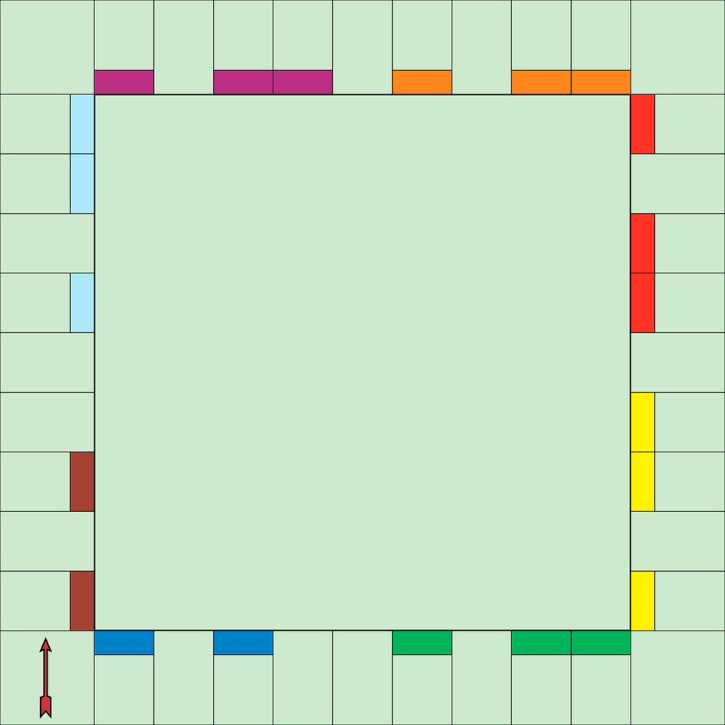









lesson resources
CHAMELEON MONOPOLY
colourful
jet-black

Slide 10




lesson resources
RULES OF THE GAME
CARDS ARE DISTRIBUTED TO THE CLASS COVERED. OR YOU CAN ACCESS THE CARDS DIGITALLY VIA THE LINK. STUDENTS TAKE TURN TO DRAW CARDS. HE ANSWERS THE SENTENCE ON THE CARDS BY SAYING TRUE OR FALSE. PROGRESS IS MADE ACCORDING TO THE SCORING ON THE BACK OF THE CARDS. (+-1,+-2,+-3....) THE TEACHER MAKES THE PROGRESS ON THE MONOPOLY BOARD. STUDENTS ARE WONDERING WHICH STEP THEY WILL COME TO. WITH EVERY STEP, THEY IMAGINE THAT THE COLOR OF THE CHAMELEON TAKES THE COLOR OF THE PLACE IT IS FOUND. STUDENTS MAY NOT WANT TO COME ON BLACK ROCKS, OR THEY MAY WANT TO REACH RAINBOW COLORS. THE GAME BOARD IS USED TO ADD SYNERGY TO THE COURSE. IN CASES WHEN THE TEACHER DETECTS THAT STUDENTS KNOW WRONG, HE PROVIDES THE NECESSARY INFORMATION TO THE WHOLE CLASS. AN INCORRECTLY ANSWERED QUESTION CAN BE USED AGAIN LATER. FOR SCORING, PLEASE REPRODUCE THE IMAGES BELOW AS STICKERS AND PASTE THEM ON THE BACK OF THE CARDS.

Slide 11
lesson resources
If someone asks for my identity information in the virtual environment, I will give them this information.
In digital conversations, everyone always tells the truth.
All games in the virtual environment are age appropriate.
If someone wants to see my photo online, I can take my photo and send it to them.

Slide 12
lesson resources
If someone is curious about my room or house, I can take a photo of it and send it to them.
When I want to buy a digital application, I consult my family.
If my virtual friend wants something to remain a secret, I realize it might be a bad secret. I share this secret with my family.
If I need to use a credit card digitally, I would never do it secretly.

Slide 13
lesson resources
I decide with my family which digital games and platforms I will use.
In the digital environment, people can bully each other more easily. I can give an example....
If comments containing bullying and rudeness have been made to the shares I have made, i will respond in the same way.
It's a problem for everyone to see the posts I make on social media i won't see.

Slide 14
lesson resources
I stay away from all kinds of insulting things in digital environments.
I use this information without investigating the accuracy of information shared on the Internet.
I click on all kinds of links that come to me digitally.
I download all kinds of programs I need from digital media without reviewing them.

Slide 15
lesson resources
Content and information belonging to others (photos, articles, graphics, etc.) permission i'll use it before I buy it.
I do not hide my identity on the Internet and make comments with words that are not appropriate for me in my real life.
With inappropriate content (leading to racism, bigotry and rudeness) i do not use websites
The Internet is a reliable source in every way.

Slide 16
lesson resources
On the Internet, without naming information that belongs to someone else i can use it.
I use my own photo and personal information on all sites.
Personal money to earn gifts or points while playing online games I share my information.
When choosing digital games, I choose games suitable for my age.

Slide 17
lesson resources
I put passwords on the digital devices I use that my family knows.
I comply with the digitalization contract we created in the classroom.
I determine together with my family how much daily digital screen time there will be.
When I stop playing digital games, I can find other pursuits that will make me feel good.

Slide 18
lesson resources
I use the report button when I see comments that are inappropriate and could harm others.

